Slide 1
EHRAgent reproduction and extension Peter Ho
https://github.com/peter-ho/EhrAgent

Slide 2

Introduction
According to https://www.thebalancemoney.com/causes-of-rising-healthcare-costs-4064878, cost of healthcare has significantly increased over past decades and years, which can be a risk for health and well being of Americans impacting every age group. I believe there are many factors with many different solutions. One of them is leveraging technology to help medical professionals to focus their time and energy on patients and/or research but not simple data retrieval or analysis.
LLM (Large Language Model) has gained signficant popularity over the past years. It can capture semantics of text, memorize past conversations, and generate code. This report evaluates past work that utilizes MIMIC dataset by reproducing and considering alternatives in data retreival and analysis.
EHRAgent was developed to leverage LLM to solve simple data retrieval or analysis against electronic health records.

Slide 3
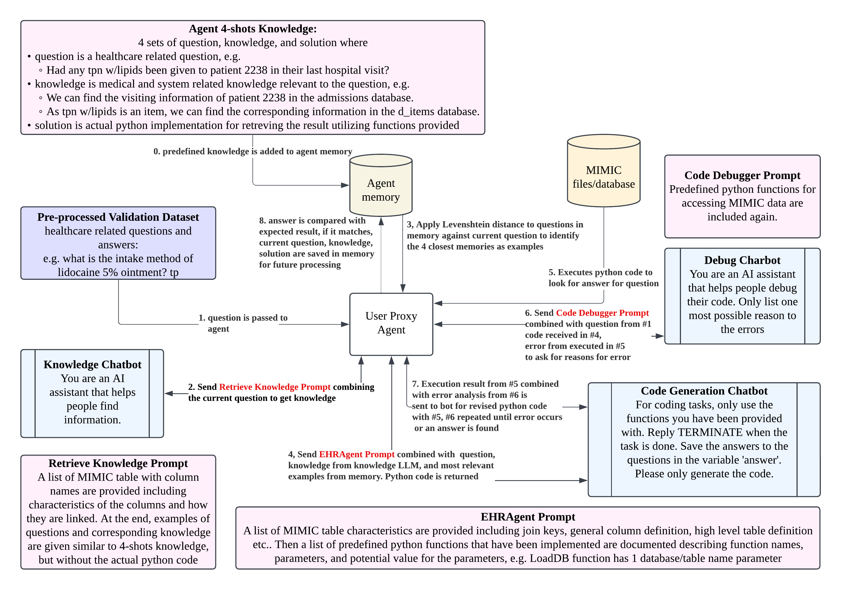
METHOD - Execution flow

Slide 4
METHod - Original Functions for chatbot
Calculate: passes argument to wolfram alpha for mathematical calculations.
LoadDB: loads a MIMIC csv file into memory.
FilterDB: filters data returned from LoadDB with predefined operators similar to SQL WHERE clause, but with a little more functionality including min and max, which selects the row equals to the minimum or maximum of the whole file.
GetValue: retrieves a string based on a comma delimited list of column names provided in table definition, with some operator supported including sum and mean.
SQLInterpreter: executes a given sql against sqlite3 database.
Calendar: evaluates the date after the duration of time based on sqlite3 database datetime function referencing current_time.

Slide 5
Issues faced during reproduction
Cost: The table cost was referenced in multiple places of the original implementation including examples, validaton questons and answers, but in MIMIC-III v1.4, cost is not a file available for download, nor in the demo dataset. Any question related to cost can't be answered, and solution based on the example referring to cost would result in a table not found error, which can't be recovered.
Python package dependency: In requirements.txt, autogen version 1.0.16 was referred, but 0.3.2 is the latest when this report was written. 0.3.3 was released afterwards, but it's still quite far from 1.0.16.
Sqlite3 calendar calculation: After setting up sqlite3 by importing MIMIC-III v1.4 csv files, sqlite3 database datetime function doesn't use current date even though current_time was passed in. It used 2000-01-01, so with input of -1 day, 1999-12-31 was returned.
LoadDB requirement: Since LoadDB reads the whole table into memory, for larger table, out of memory exception was thrown. Due to re-reading the same csv or csv.gz files for every LoadDB command for various questions, disk IO can cause unnecessary delays when reading against the same data.
Validation set issue: When trying to identify reasons for incorrect responses, SQL embedded in the validation data set was used to identify and verify given answers. There are answers that are incorrect based on data retrieved from MIMIC-III v1.4.
Execution challenge: Since some code generated by chatbot can be quite inefficient, there are times that it takes more than hours to run, and sometimes it can be hard to tell how long it will take for the process to terminate. So with more than 500 validation questions, it takes more than days to finish evaluating 1 implementation.

Slide 6
Adjustments
Cost: Since examples related to cost won't be relevant and validation questions related to cost will not work, 24 questions and answers involving costs were removed. Examples related to costs were also adjusted to better illustrate other implementation.
Python Package Dependency: Autogen 0.3.2 was used instead of 1.0.16, flaml[automl] was added due to other dependency. And mariadb 1.1.11 was added to support accessing MariaDB.
Sqlite3 Calendar Calculation: Calendar calculation was changed to MariaDB DATE_ADD which evaluates duration based on current datetime instead of 2000.
LoadDB Requirement: LoadDB and several other functions are changed to defer execution similar to Apache Spark, so only result after filtering and selected columns is returned and read from data source.
Execution Challenge: Due to the time sensitive nature of this report, when the evaluation of a question takes more 45 minutes, the process is killed with question id marked as not complete and restarted.
Database Backend: To help improve data operations, instead of loading from files every time, all operations invokes MariaDB backend with database indexes setup for larger tables.
New Functions: Given database operations aren't as straightforward to be mapped with results returning multiple values or list when only one value is needed, new functions are added including GetValue getting a single, GetValues getting multiple values, GetCount counting the number of rows of a data set.

Slide 7
results
 | Number of questions | Success Rate | Completion Rate
EHRAgent | 581 | 53.10 | 91.72
EHRAgent without cost | 556 | 26.08 | 69.96
EHRAgent with MariaDB without cost | 556 | 26.08 | 69.96

Slide 8
Future directions
Have a set of verification questions and ground truth answers matching the test data.
Adjust initial memory so they are more diverse.
Persist memory captured by answering questions correctly so that when the process hangs and needs to be destroyed, memory can be recovered.
Provide more robust filtering examples, as some generated code has applied multiple filtering which can be incorrect in some cases.

Slide 9
references
A. Goldberger, L. Amaral, L. Glass, J. Hausdorff, P.C. Ivanov, R. Mark, J.E. Mietus, G.B. Moody, C.K. Peng, and H.E. Stanley.2000. PhysioBank, PhysioToolkit, and PhysioNet: Components of a new research resource for complex physiologicsignals. Circulation [Online]. (2000), e215–e220. https://doi.org/10.13026/C2XW26
Alistair Johnson, Tom Pollard, and Roger Mark. 2016. MIMIC-III Clinical Database. version 1.4 (2016). https://doi.org/10.13026/C2XW26
Alistair E.W. Johnson, Tom J. Pollard, Lu Shen, Li-wei H. Lehman, Mengling Feng, Mohammad Ghassemi, BenjaminMoody, Peter Szolovits, Leo Anthony Celi, and Roger G. Mark. 2016. MIMIC-III, a freely accessible critical care database.Scientific Data 3 (2016). Issue 1. https://doi.org/10.1038/sdata.2016.35
Wenqi Shi, Ran Xu, Yuchen Zhuang, Yue Yu, Jieyu Zhang, Hang Wu, Yuanda Zhu, Joyce Ho, Carl Yang, and May DWang. 2024. Ehragent: Code empowers large language models for complex tabular reasoning on electronic healthrecords. EMNLP (2024).
Ping Wang, Tian Shi, and Chandan K Reddy. 2020. Text-to-SQL Generation for Question Answering on ElectronicMedical Records. In Proceedings of The Web Conference 2020. 350–361.

